Slide 1

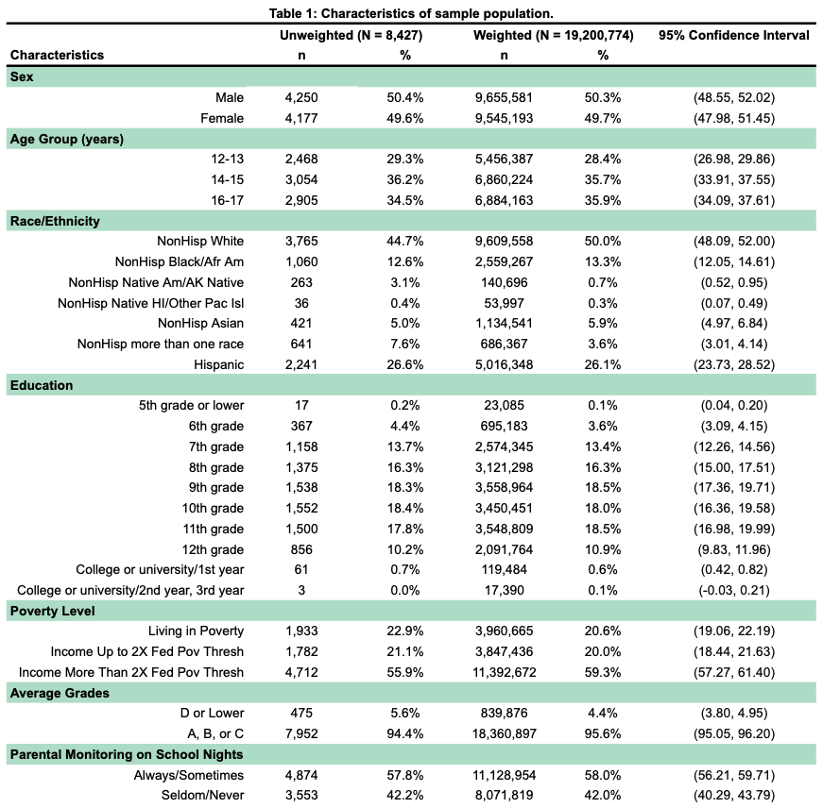
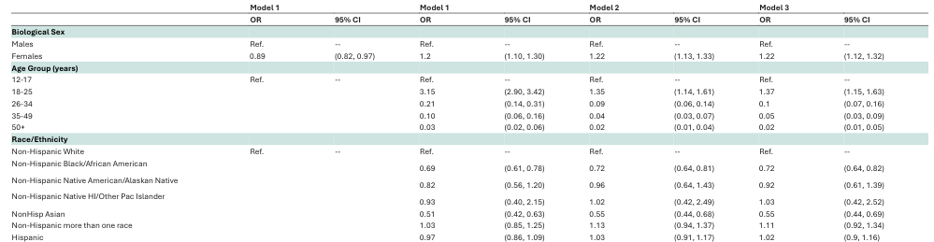
Estimating the Relationship Between Drug Use and Major Depressive Episodes Among Youth
Keele J. Thomas, Master of Public Health Candidate
Samantha J. Bauer, PhD, Assistant Professor, Department of Family Medicine and Public Health Sciences
Introduction
Results
Results Continued…
This study estimates the relationship between drug use history and the lifetime prevalence of a Major Depressive Episode (MDE) among US adolescents aged 12-17, utilizing data from the National Survey on Drug Use and Health (NSDUH). Adolescence is a critical period characterized by increased risk for both substance use initiation and the onset of mood disorders.¹,²,³ This study aims to disaggregate drug use into cultural categories—“soft” versus “hard” drugs—to determine if the type of substance use differentially predicts MDE status in this specific age group, thereby providing nuanced evidence for targeted early intervention strategies.
EXAMPLE
Table 2 – Results from any drug use regression model.
EXAMPLE
Methods
This study employs a cross-sectional, secondary data analysis of the NSDUH public-use data file. The sample is restricted to youth only, defined as respondents aged 12-17 who completed the survey’s adolescent section. The primary outcome variable is the self-reported, lifetime MDE, as defined by the NSDUH based on DSM-5 criteria. The primary predictor variables are constructed from lifetime “ever tried” responses for specific substances, categorized as:
“Soft” Drugs: Alcohol, Nicotine (cigarettes, cigars, vaping, smokeless tobacco, etc.), Marijuana and CBD/Hemp.
“Hard” Drugs: Cocaine, Crack, Methamphetamine, Heroin, Hallucinogenics, Inhalants, and non-medical use of prescription drugs (e.g. pain relievers, tranquilizers).
Any Drug Use: A binary variable indicating the use of any substance in either category.
Logistic regression models were used to estimate the odds ratios (OR) for the association between each drug use category (any, soft, and hard) and the likelihood of reporting a lifetime MDE, controlling for relevant demographic/confounding? variables (e.g., sex, age, race, etc.).
Table 3 – Results from any “soft” drug use regression model.
EXAMPLE
Table 1 – Characteristics of sample population.
Table 4 – Results from any “hard” drug use regression model.
Conclusion
*Preliminary* Results are consistent with existing literature: across all categories—any drug use, “soft” drug use, and “hard” drug use—a history of drug use is significantly associated with substantially increased odds of having experienced a lifetime MDE. Furthermore, females with a history of drug use have a TBD times increased risk of having experienced a lifetime MDE. Evidencing that early intervention strategies should target females in the age range of TBD in order to decrease lifetime incidences of MDE.
References
References
Acknowledgments
Hansen ER, Kruckow S, Ewing SWF, Nordentoft M, Thomsen KR, Tolstrup JS. Adolescent substance use patterns and subsequent risk of mental and behavioural disorders, substance use, and suicidal behaviour: a cohort study. Lancet Public Health. 2025 Jul;10(7):e578-e587. doi: 10.1016/S2468-2667(25)00115-X. PMID: 40602857.
Barry CM, Jagtiani A, Livingston MD, Talavera-Brown S, LaBounty H, Atkinson E, Skinner JR, Komro KA. Anxiety and depressive symptoms as predictors of substance use initiation among adolescents living on and near a Tribal reservation in the Great Plains region of the U.S. Front Child Adolesc Psychiatry. 2024;3:1390793. doi: 10.3389/frcha.2024.1390793. Epub 2024 Nov 18. PMID: 39640212; PMCID: PMC11619325.
Gray KM, Squeglia LM. Research Review: What have we learned about adolescent substance use? J Child Psychol Psychiatry. 2018 Jun;59(6):618-627. doi: 10.1111/jcpp.12783. Epub 2017 Jul 17. PMID: 28714184; PMCID: PMC5771977.
I extend my deepest gratitude and sincere appreciation to Dr. Samantha Bauer for her unwavering support and guidance throughout this research experience. Her role extended far beyond that of a typical advisor; she has been an exceptional source of kindness and understanding. Her encouragement was instrumental in navigating the HSDUH data and the complex statistical analysis. Dr. Bauer’s support and insightful feedback were crucial to the completion of this study, and I am truly thankful for her dedication to my academic growth.

Slide 2
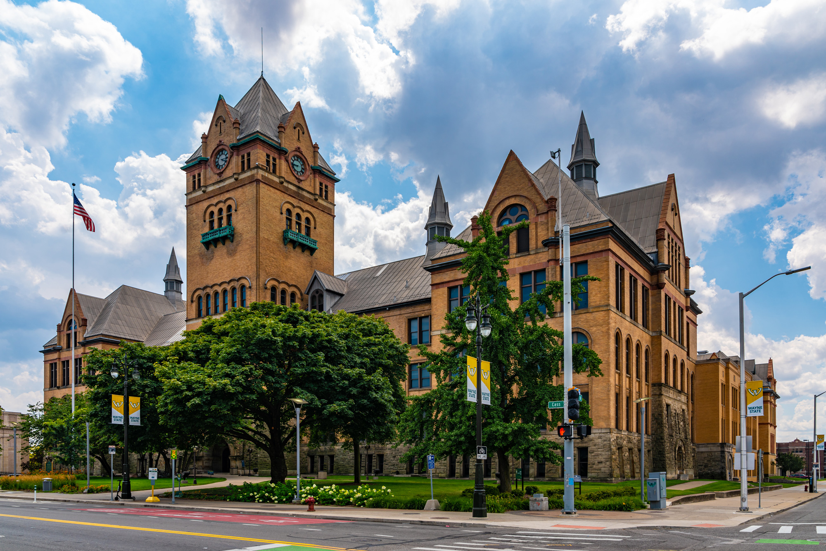



Title – this is a 48” x 36” (4’ x 3’) poster, 88 point Lato heavy title heading, legible at 16 feet away
Authors and affiliations
54 point Lato medium body
Introduction
Methods
Conclusion
Any posters that are meant to be read at a minimum distance; the following sizes are suggested:
Title: 88 pt bolded
Authors and affiliations: 54 - 60 pt
Headings: 36 pt
Body text: 24 - 32 pt
Captions: 18 pt
For readability, the following sizes are suggested for the body text:
To be legible at 6 feet use 30 point. (most common for conferences)
To be legible at 10 feet use 48 point.
To be legible at 12 feet use 60 point.
To be legible at 14 feet use 72 point.
Text and figures should be readable from around 5-7 feet away
Use a sans serif typeface (e.g., Lato, Arial, Open Sans, Helvetica, etc.). Our poster templates use the sans serif font Lato, which can be downloaded from the link provided on our FAQ page or from Google: https://fonts.google.com/specimen/Lato
This poster uses Lato font and the theme has been mapped to that font. If you copy/paste text from documents, please ensure fonts are correct. Mismatched fonts in posters are a distraction and aesthetically degrades the quality of your presentation.
For more information about creating accessible design with color and type, please reference https://medcom.med.wayne.edu/creating-accessible-design
Text – good examples
Text should be high contrast, the following provide the best contrast for reading and printing:
Black on white
WSU primary green on white
Dark gray on white
WSU primary green on WSU primary yellow
WSU primary yellow on WSU primary green
White on WSU primary green
Text – poor/inaccessible examples
Text should be high contrast, the example to the right illustrates the worst examples of contrast, making it inaccessible for individuals that have vision impairment. This is what's called “designed to fail” as this assumes everyone can read the content, however, it does the opposite – it excludes people with vision impairments (and even good sighted individuals).
Black on white
Light green on WSU primary green
Dark gray on WSU primary green
White on WSU primary yellow
Black on WSU primary green
Red on WSU primary green
Red does not mean this is important! When deciding to change your content's font color for important information, ensure the font color is not the only means of identification. Bolding, italicizing and scale can function as indicators of importance.
WSU color branding quick guide.
For detailed information about WSU color branding, please visit the FAQ section on our website and select the WSU color under the WSU branding section.
WSU primary green
hex (#0c5449) rgb (12, 84, 73)
WSU primary yellow
hex (#ffcc33) rgb (255, 204, 51)
Grey accent
hex (#d9d9d9) rgb (217, 217, 217)
Below are 3 accent gradients you can use as part of the WSU color branding.
Results
High resolution WSU logos. Proportionally scaled down. If you need to enlarge, please LOCK ASPECT RATIO in the shape format tab! Do not stretch or scale without aspect ratio selected or scale above 100%.
Include a brief caption for figure(s), and explicitly refer to the figure in the text, which includes labeling with legible fonts and font sizes
Figures (Figure 1) should advance the points you’re making in the text
Ensure images and figures (Figure 2) are sufficiently high resolution for enlargement (Figure 3)
Figure 1 - reference figures in your poster. Suggested caption text size is 18 point
References
References
References
We hope you find these tips helpful! If you have any questions, please call the department of Medical Communications at Wayne State University School of Medicine at 313-577-1482 or email medcom@med.wayne.edu We are open Monday through Friday, 8:30 a.m. through 5 p.m. and closed for university recognized holidays.
Figure 2 – example chart
Figure 3 – example chart

